Slide 1
Classes

Slide 2
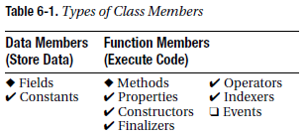
Class Members
We already learned two of the nine types of class members: fields and methods. Today , I will introduce more types of class members, and discuss the lifetimes of class
members.
Table shows a list of the class member types. Those that have already been introduced are marked with diamonds. Those that will be covered in this chapter are marked with a check.
Those that will be covered later in the text are marked with empty check boxes.

Slide 3
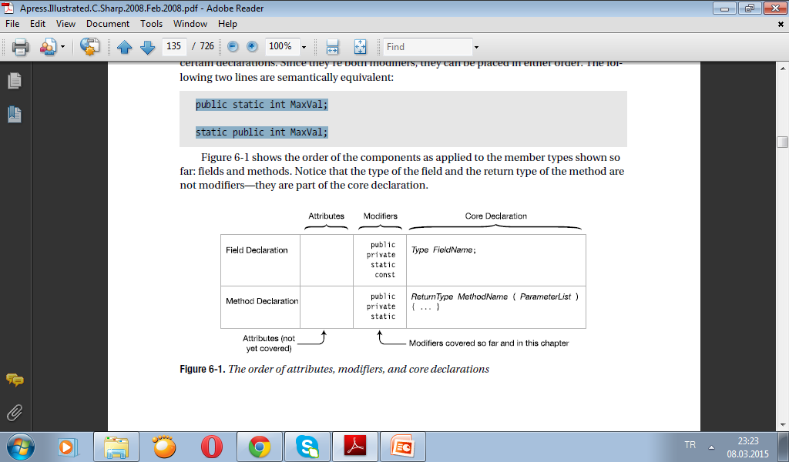
Order of Member Modifiers
Previously, we saw that the declarations of fields and methods can include modifiers such as public and private. I will discuss a number of additional modifiers. Since many
of these modifiers can be used together, the question that arises is: what order do they need to be in?
When a declaration has multiple modifiers, they can be placed in any order before the core declaration. So far, I’ve only discussed two modifiers: public and private. When there are multiple attributes, they can be placed in any order before the modifiers.
public and static are both modifiers that can be used together to modify certain declarations. Since they’re both modifiers, they can be placed in either order. The following two lines are semantically equivalent:
public static int MaxVal;
static public int MaxVal;

Slide 4
Instance Class Members
Class members can be associated with an instance or with the class as a whole. By default,
members are associated with an instance. You can think of each instance of a class as having its own copy of each class member. These members are called instance members.
class D
{
public int Mem1;
}
class Program
{
static void Main()
{
D d1 = new D();
D d2 = new D();
d1.Mem1 = 10; d2.Mem1 = 28;
Console.WriteLine("d1 = {0}, d2 = {1}", d1.Mem1, d2.Mem1);
}
}
d1 = 10, d2 = 28

Slide 5
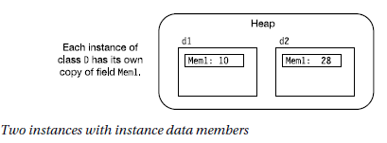
Static Fields
Besides instance fields, classes can also have static fields.
A static field is shared by all the instances of the class, and all the instances access the
same memory location. Hence, if the value of the memory location is changed by one instance, the change is visible to all the instances.
Use the static modifier to declare a field static, as follows:
class D
{
int Mem1; // Instance field
static int Mem2; // Static field
↑
} Keyword

Slide 6
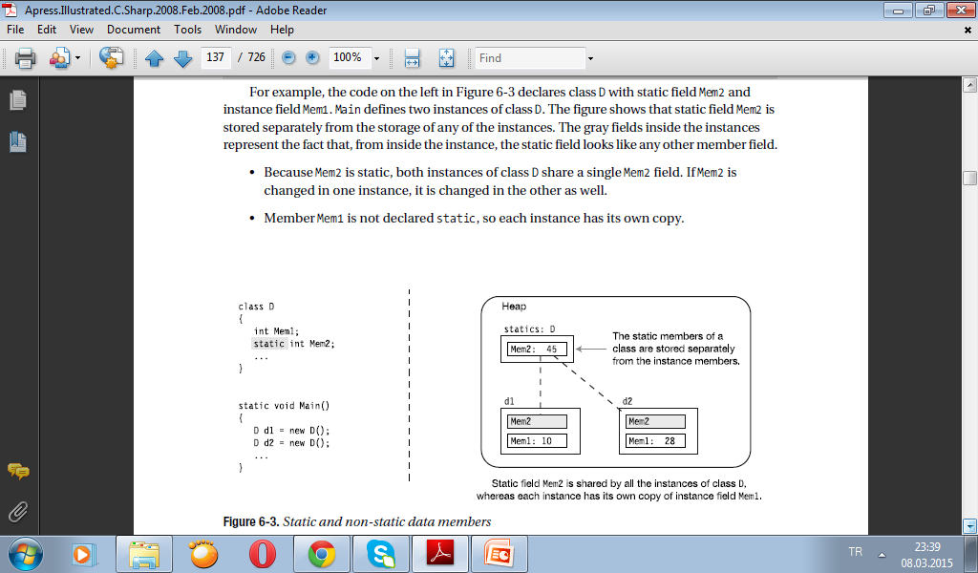
The figure shows that static field Mem2 is stored separately from the storage of any of the instances. The gray fields inside the instances represent the fact that, from inside the instance, the static field looks like any other member field.
• Because Mem2 is static, both instances of class D share a single Mem2 field. If Mem2 is changed in one instance, it is changed in the other as well.
• Member Mem1 is not declared static, so each instance has its own copy.

Slide 7
Accessing Static Members from Outside the Class
Static members, like instance members, are also accessed from outside the class using dotsyntax notation. But since there is no instance, you must use the class name, as shown here:
D.Mem2 = 5; // Accessing the static class member
class D
{
int Mem1;
static int Mem2;
public void SetVars(int v1, int v2) // Set the values
{ Mem1 = v1; Mem2 = v2; }
↑ Access as if it were an instance field
public void Display( string str )
{
Console.WriteLine("{0}: Mem1= {1}, Mem2= {2}", str, Mem1, Mem2);
} ↑
Access as if it were an instance field
}

Slide 8
class Program
{
static void Main()
{
D d1 = new D(), d2 = new D(); // Create two instances.
d1.SetVars(2, 4); // Set d1's values.
d1.Display("d1");
d2.SetVars(15, 17); // Set d2's values.
d2.Display("d2");
d1.Display("d1"); // Display d1 again and notice that the
} // value of static member Mem2 has changed!
}
d1: Mem1= 2, Mem2= 4
d2: Mem1= 15, Mem2= 17
d1: Mem1= 2, Mem2= 17

Slide 9
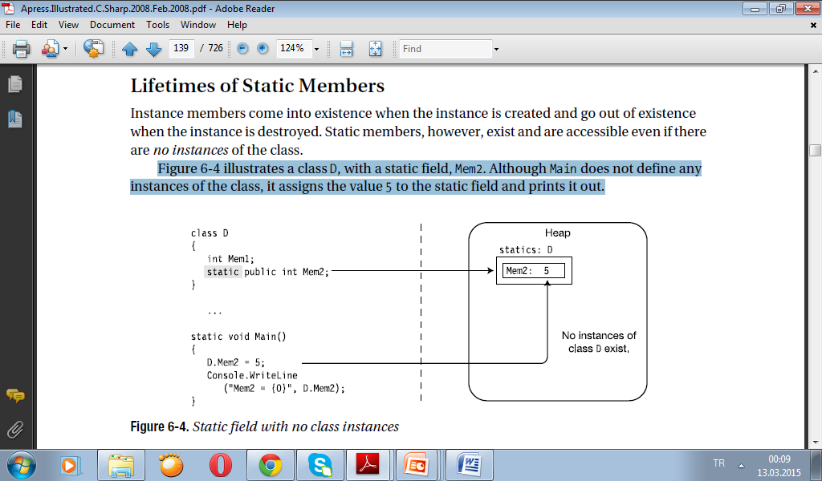
Lifetimes of Static Members
Instance members come into existence when the instance is created and go out of existence when the instance is destroyed. Static members, however, exist and are accessible even if there are no instances of the class.
Figure illustrates a class D, with a static field, Mem2. Although Main does not define any instances of the class, it assigns the value 5 to the static field and prints it out.

Slide 10
Static Function Members
Besides static fields, there are also static function members.
• Static function members, like static fields, are independent of any class instance. Even if there are no instances of a class, you can still call a static method.
• Static function members cannot access instance members. They can, however, access other static members.
For example, the following class contains a static field and a static method. Notice that the body of the static method accesses the static field.
class X
{
static public int A; // Static field
static public void PrintValA() // Static method
{
Console.WriteLine("Value of A: {0}", A);
} ↑
} Accessing the static field
The following code uses class X, defined in the preceding code
class Program
{
static void Main()
{
X.A = 10; // Use dot-syntax notation
X.PrintValA(); // Use dot-syntax notation
} ↑
} Class name

Slide 11
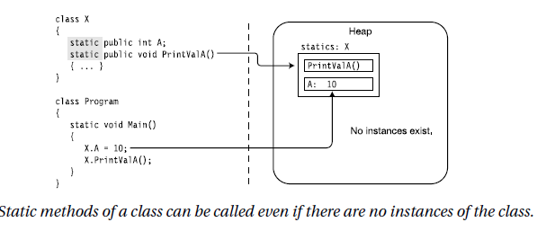
class Program
{
static void Main()
{
X.A = 10; // Use dot-syntax notation
X.PrintValA(); // Use dot-syntax notation
} ↑
} Class name

Slide 12
Member Constants
Member constants are like the local constants covered in the previous chapter, except that they are declared in the class declaration, as in the following example:
class MyClass
{
const int IntVal = 100; // Defines a constant of type int
↑ ↑ // with a value of 100.
} Type Initializer
const double PI = 3.1416; // Error: cannot be declared outside a type
// declaration
Like local constants, the value used to initialize a member constant must be computable
at compile time, and is usually one of the predefined simple types or an expression composed of them.
class MyClass
{
const int IntVal1 = 100;
const int IntVal2 = 2 * IntVal1; // Fine, since the value of IntVal1
} // was set in the previous line.

Slide 13
Like local constants, you cannot assign to a member constant after its declaration.
class MyClass
{
const int IntVal; // Error: initialization is required.
IntVal = 100; // Error: assignment is not allowed.
}.
Constants Are Like Statics
Member constants, however, are more interesting than local constants; they act like static values. They are “visible” to every instance of the class, and they are available even if there are no instances of the class.
For example, the following code declares class X with constant field PI. Main does not create any instances of X, and yet it can use field PI and print its value.
class X
{
public const double PI = 3.1416;
}
class Program
{
static void Main()
{
Console.WriteLine("pi = {0}", X.PI); // Use static field PI
}
}

Slide 14
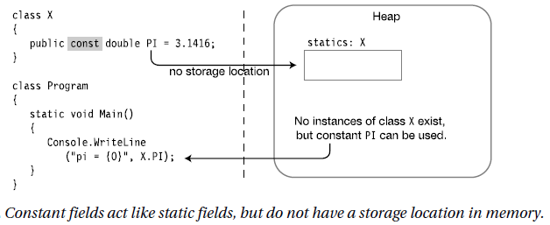
Unlike actual statics, however, constants do not have their own storage locations, and are substituted in by the compiler at compile time in a manner similar to #define values in C and C++. This is shown in Figure 6-6, which illustrates the preceding code. Hence, although a constant member acts like a static, you cannot declare a constant as static.
static const double PI = 3.14;
Error: can't declare a constant as static

Slide 15
Properties
A property is a member that represents an item of data in a class instance or class.
Using a property appears very much like writing to, or reading from, a field. The syntax is
the same. For example, the following code shows the use of a class called MyClass that has both a public field and a public property. From their usage, you cannot tell them apart.
MyClass mc = new MyClass();
mc.MyField = 5; // Assigning to a field
mc.MyProperty = 10; // Assigning to a property
WriteLine("{0} {1}", mc.MyField, mc.MyProperty); // Read field and property
A property, like a field, has the following characteristics:
• It is a named class member.
• It has a type.
• It can be assigned to and read from.
Unlike a field, however, a property is a function member.
• It does not allocate memory for data storage!
• It executes code.
A property is a named set of two matching methods called accessors.
• The set accessor is used for assigning a value to the property.
• The get accessor is used for retrieving a value from the property.

Slide 16
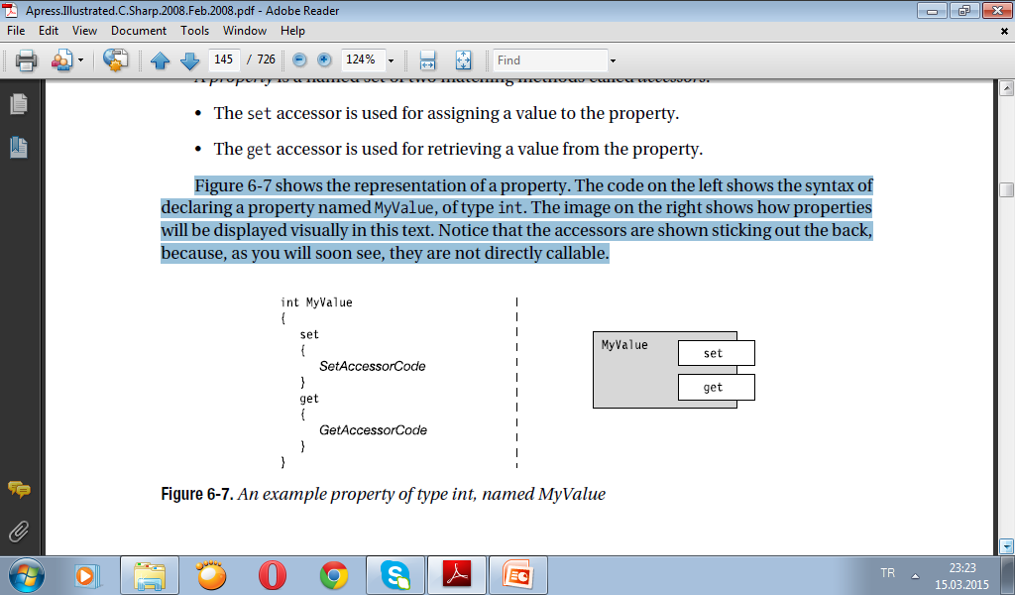
Figure shows the representation of a property. The code on the left shows the syntax of declaring a property named MyValue, of type int. The image on the right shows how properties will be displayed visually in this text. Notice that the accessors are shown sticking out the back, because, as you will soon see, they are not directly callable.

Slide 17
Property Declarations and Accessors
The set and get accessors have predefined syntax and semantics. You can think of the set accessor as a method with a single parameter that “sets” the value of the property. The get accessor has no parameters and returns a value from the property.
• The set accessor always has the following:
– A single, implicit value parameter named value, of the same type as the property
– A return type of void
• The get accessor always has the following:
– No parameters
– A return type of the same type as the property
The structure of a property declaration is shown in Figure. Notice in the figure that neither accessor declaration has explicit parameter or return type declarations. They don’t need them, because they are implicit in the type of the property.

Slide 18
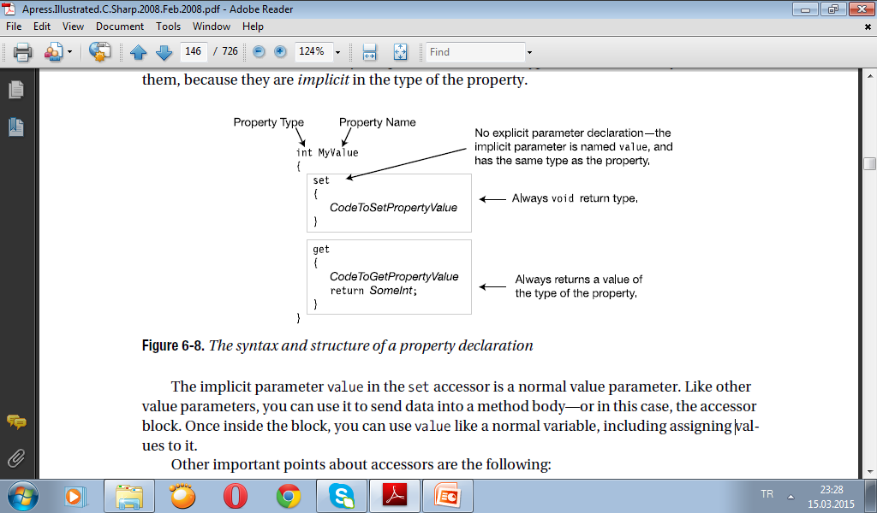

Slide 19
The implicit parameter value in the set accessor is a normal value parameter. Like other value parameters, you can use it to send data into a method body—or in this case, the accessor block. Once inside the block, you can use value like a normal variable, including assigning values to it.
Other important points about accessors are the following:
• All paths through the implementation of a get accessor must include a return statement that returns a value of the property type.
• The set and get accessors can be declared in either order, and no methods other than the two accessors are allowed on a property.

Slide 20
A Property Example
The following code shows an example of the declaration of a class called C1 that contains a property named MyValue.
• Notice that the property itself does not have any storage. Instead, the accessors determine what should be done with data sent in, and what data should be sent out. In this case, the property uses a field called TheRealValue for storage.
• The set accessor takes its input parameter, value, and assigns that value to field
TheRealValue.
• The get accessor just returns the value of field TheRealValue.
class C1
{
private int TheRealValue; // Field: memory allocated
public int MyValue // Property: no memory allocated
{
set
{
TheRealValue = value;
}
get
{
return TheRealValue;
}
}
}

Slide 21
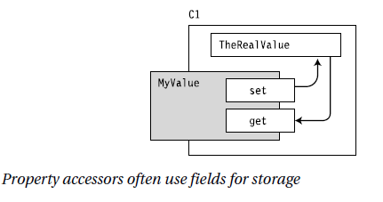

Slide 22
An Example of Traditional Class Field Access
using System;
public class Customer
{
private int m_id = -1;
public int GetID()
{
return m_id;
}
public void SetID(int id)
{
m_id = id;
}
private string m_name = string.Empty;
public string GetName()
{
return m_name;
}
public void SetName(string name)
{
m_name = name;
}
}
public class CustomerManagerWithAccessorMethods
{
public static void Main()
{
Customer cust = new Customer();
cust.SetID(1);
cust.SetName("Amelio Rosales");
Console.WriteLine(
"ID: {0}, Name: {1}",
cust.GetID(),
cust.GetName());
Console.ReadKey();
}
}

Slide 23
public class CustomerManagerWithAccessorMethods
{
public static void Main()
{
Customer cust = new Customer();
cust.SetID(1);
cust.SetName("Amelio Rosales");
Console.WriteLine(
"ID: {0}, Name: {1}",
cust.GetID(),
cust.GetName());
Console.ReadKey();
}
}

Slide 24
Accessing Class Fields With Properties
using System;
public class Customer
{
private int m_id = -1;
public int ID
{
get
{
return m_id;
}
set
{
m_id = value;
}
}
private string m_name = string.Empty;
public string Name
{
get { return m_name; }
set { m_name = value; }
}
}

Slide 25
public class CustomerManagerWithProperties
{
public static void Main()
{
Customer cust = new Customer();
cust.ID = 1;
cust.Name = "Amelio Rosales";
Console.WriteLine( "ID: {0}, Name: {1}", cust.ID, cust.Name);
Console.ReadKey();
}
}

Slide 26
Creating Read-Only Properties
Properties can be made read-only. This is accomplished by having only a get accessor in the property implementation. Listing 10-3 demonstrates how you can create a read-only property.
using System;
public class Customer
{
private int m_id = -1;
private string m_name = string.Empty;
public Customer(int id, string name)
{
m_id = id;
m_name = name;
}
public int ID
{
get { return m_id; }
}
public string Name
{
get { return m_name; }
}
}

Slide 27
public class ReadOnlyCustomerManager
{
public static void Main()
{
Customer cust = new Customer(1, "Amelio Rosales");
Console.WriteLine( "ID: {0}, Name: {1}", cust.ID, cust.Name);
Console.ReadKey();
}
}

Slide 28
Write-Only Properties
using System;
public class Customer
{
private int m_id = -1;
public int ID
{
set { m_id = value; }
}
private string m_name = string.Empty;
public string Name
{
set { m_name = value; }
}
public void DisplayCustomerData()
{
Console.WriteLine("ID: {0}, Name: {1}", m_id, m_name);
}
}

Slide 29
public class WriteOnlyCustomerManager
{
public static void Main()
{
Customer cust = new Customer();
cust.ID = 1;
cust.Name = "Amelio Rosales";
cust.DisplayCustomerData();
Console.ReadKey();
}
}

Slide 30
Auto-Implemented Properties
using System;
public class Customer
{
public int ID { get; set; }
public string Name { get; set; }
}
public class AutoImplementedCustomerManager
{
static void Main()
{
Customer cust = new Customer();
cust.ID = 1;
cust.Name = "Amelio Rosales";
Console.WriteLine( "ID: {0}, Name: {1}", cust.ID, cust.Name);
Console.ReadKey();
}
}

